Slide 1


Data
We Are Learning To:
We are learning to collect and represent data.
What I’m Looking For:
I can watch carefully and count accurately.
I can record information using tally marks.
I can count my tally marks to find the total.
I can use my data to create a clear graph.
I can answer questions about my graph.
Notes:
Layer 1.png

Slide 2

What is Data?
Data is information that we collect.
We collect data to find out answers to questions.
When we gather information and organise it, that is called data.
Notes:
Layer 1.png

Slide 3

Data is Everywhere
We see data every day
Counting how many students are at school
Finding out everyone’s favourite fruit
Counting sunny and rainy days
Counting how many cars drive past
When we count and record information, we are collecting data.
Notes:
Layer 1.png

Slide 4

Why do we collect data?
We collect data to:
Answer questions
Compare information
Find out what is most and least
Help us make decisions
Data helps us understand the world around us.
Notes:
Layer 1.png

Slide 5

How do we Collect Data?
We collect data by:
Asking questions
Watching carefully
Counting
Survey others
Notes:
Layer 1.png

Slide 6

What is a Tally Mark
A tally mark is a quick way to count.
We draw one line for each item.
When we get to 5, we draw a line across.
Tally marks help us count quickly and neatly.
Notes:
Layer 1.png

Slide 7





Collecting Data
Let’s collect some data and record it as tally marks. Pick your favourite fruit and click on the picture of the fruit to add a tally mark:
Click on the pictures
Notes:
Layer 1.png

Slide 8

How Can we Represent Data?
After we collect data, we need to show it. We can show the data using:
Tally charts
Picture graphs
Column graphs
Bar graphs
Graphs help us see information clearly.
Notes:
Layer 1.png

Slide 9




What is a Graph?
Insects in the Garden
15
14
13
12
11
10
9
8
7
6
5
4
3
2
1
A graph is a picture of our data. It helps us see:
What we have the most of
What we have the least of
If 2 groups are the same.
Graphs make information easy to understand.
What do you notice about this graph?
Notes:
Layer 1.png

Slide 10





Collecting Data
Pets
15
14
13
12
11
10
9
8
7
6
5
4
3
2
1
Pick your favourite pet and click on the picture of
the pet to add a tally mark or a box on the graph.
 | Tally
Click on the pictures
Click on the pictures

Slide 11
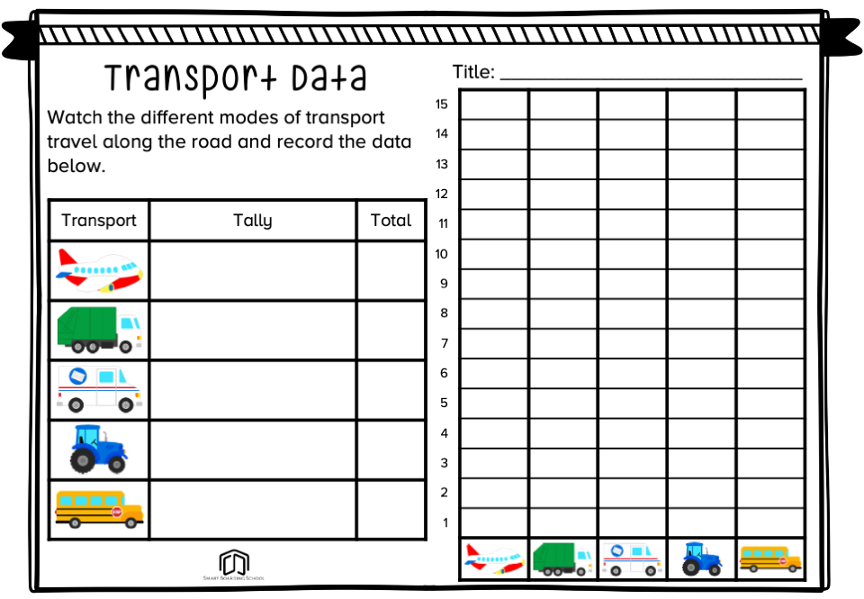
Let’s Collect Transport Data
Let’s use what we have learnt about tallies and graph to represent different types of transport. On the next slide:
Watch the different types of transport that travels across the screen.
Use tally marks to record what we see.
Count the totals
Use the data to create a graph to show our data.
Notes:
Layer 1.png

Slide 12


