Slide 1
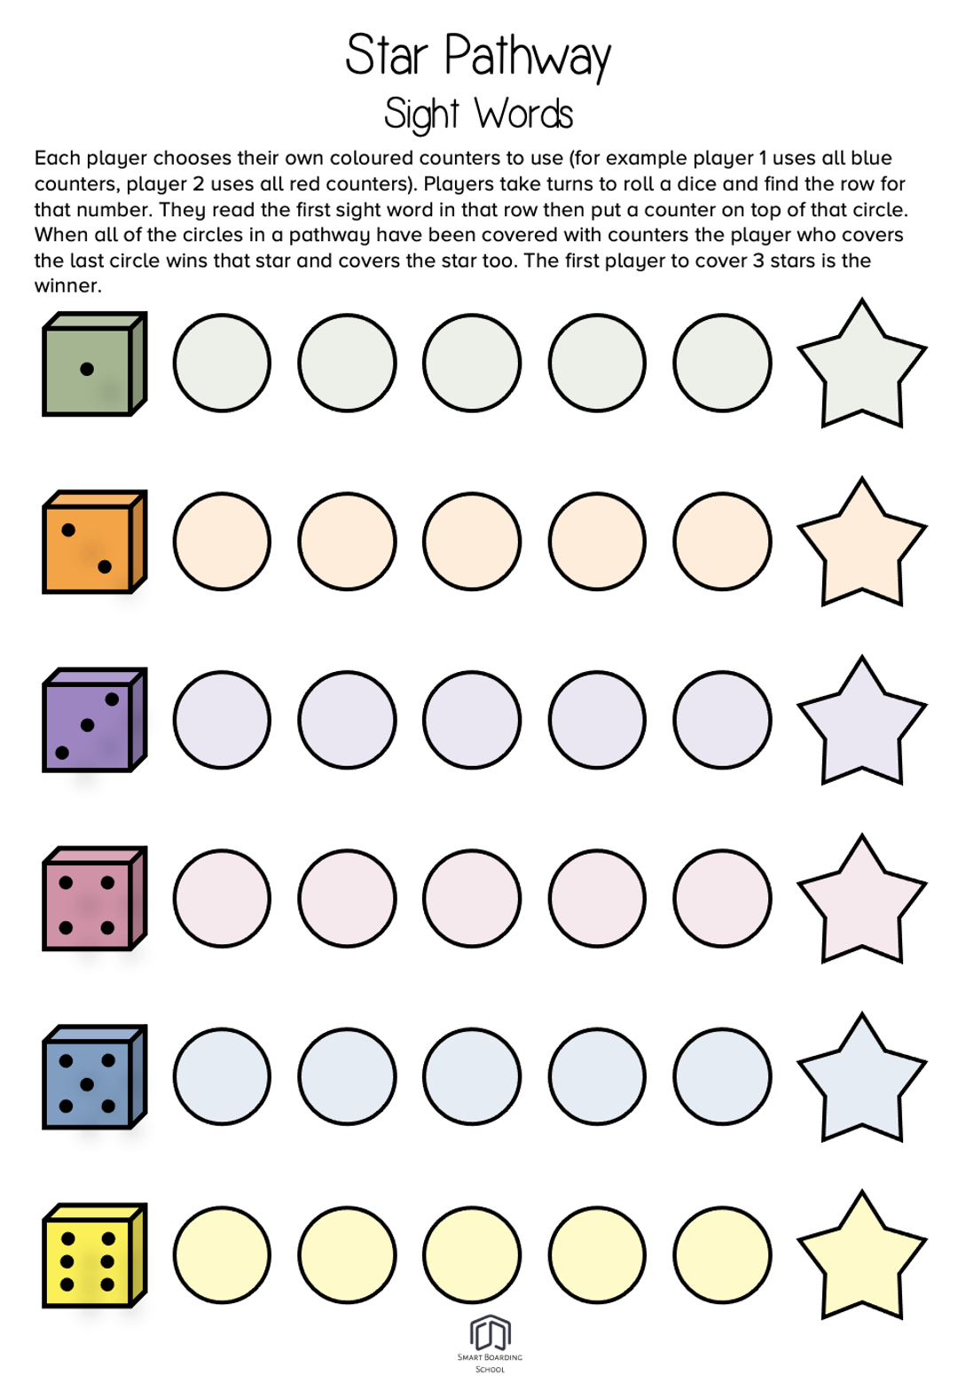
word
word
word
word
word
word
word
word
word
word
word
word
word
word
word
word
word
word
word
word
word
word
word
word
word
word
word
word
word
word

