Slide 2
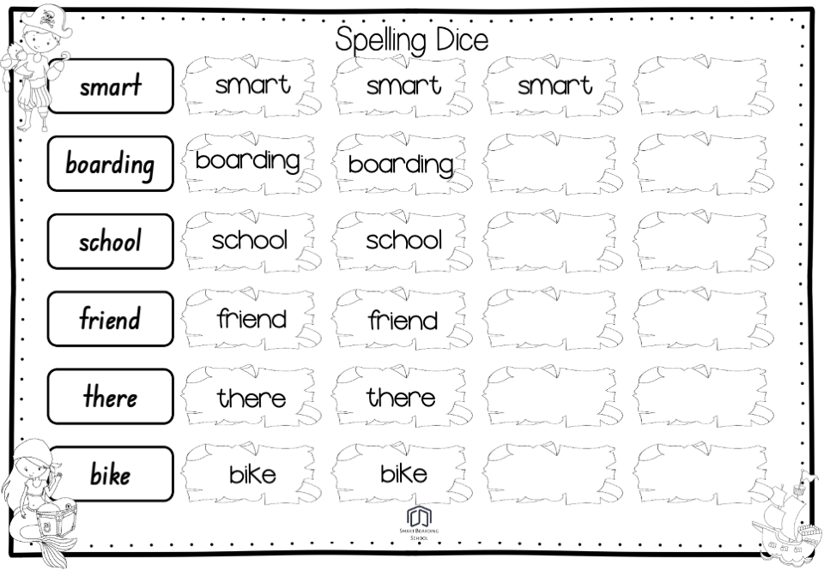
Spelling Dice
Type 6 spelling words into the boxes on page 2 and print a copy for each student playing the game.
How to play:
Play in groups of 3
Players take turns to roll a die.
If a player rolls a 6 or a 1 they can start writing spelling words in the treasure maps.
The other 2 players keep taking tuns to roll the die.
When a 6 or 1 is rolled, the player that rolled a 6 or 1 can now start writing spelling words on their page.
Continue until 1 player has run out of spaces to write spelling words.
The winner is the player who fills their treasure maps first.

Slide 3
Spelling word
Spelling word
Spelling word
Spelling word
Spelling word
Spelling word

